Slide 1
Guidelines for Capstone Project
ISTE Approved
Free One WEEK Online WORKSHOP on
"Joy of Programming using Python"
Dates: (April 25-May 1, 2020)
Organized by
Computer Engineering Department, C.K.Pithawala College of Engineering & Technology, Surat, Gujarat State, India.

Slide 2
Overall Objective:
Strengthen your understanding & learning of python programming through practical application
Gain experience of solving Data Science / Data Analytics problems
Get familiar with commonly used data processing python libraries

Slide 3
Rules:
Team of max 3 people
The problem size should increase in proportion to every extra team member
The presentation of 3-4 slides with working demo should be submitted on github
Deadline is an hour before the start of presentation
You may fail upon unsatisfactory project work
Demo day, 10 min presentation + 2 min QA

Slide 4
Project Topic Guidelines
Scope: 1 Person
The exploratory data analysis on open source dataset. The result is interesting insights into dataset.
Scope: 2 Person or Less
The feature engineering and data analysis using multiple datasets/data source to find predefined question.
Scope: 3 Person or Less
The feature engineering and exploratory data analysis. Build machine learning model and report the model evaluation matrix.

Slide 5
First Slide Example

Slide 6

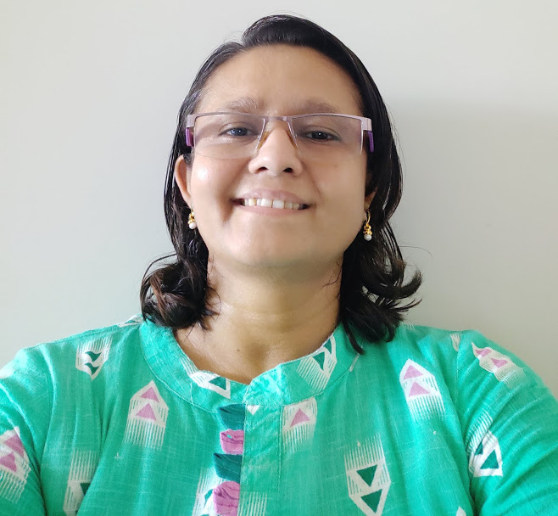
Title of Project
ISTE Approved
Free One WEEK Online WORKSHOP on
"Joy of Programming using Python"
Dates: (April 25-May 1, 2020)
Organized by
Computer Engineering Department, C.K.Pithawala College of Engineering & Technology, Surat, Gujarat State, India.
Mr. Nishant M. Gandhi
Enrollment no:111111
College: CKPCET, Surat
email:(nishantgandhi99@gmail.com )
Dr. Ami T. Choksi
Enrollment no:4444
College: CKPCET, Surat
(ami.choksi@ckpcet.ac.in)

Slide 7
Best Wishes!!!

